Slide 1
What factors drive restaurant inspection failures in NYC?
C601
Data-driven strategies for improving food safety outcomes
Morgan, Luai, Briana
Notes:
Hi everyone. Today we're presenting our analysis on restaurant inspection failures in New York City and evidence-based recommendations to improve food safety outcomes.

Slide 2
Agenda
Background
Objectives
Data Visualizations
Summary
Recommendations
Conclusion
Notes:
This is our agenda for today, we’ll be going over the background, objectives, data visualizations, summary, recommendations and ending it with the conclusion.

Slide 3

New York is a cultural food capital showcasing a diverse body of restaurant types
New York City boasts 25,000+ restaurants reflecting its rich cultural and culinary diversity, but that scale also creates public health challenges.

Slide 4





Background
What is a restaurant inspection?
Why are restaurant inspections important?
A restaurant inspection is an official evaluation conducted by local health department officials to ensure restaurants and food service establishments are following food safety regulations and health codes.
Restaurant inspections are crucial for several key reasons:
Public health protection: prevent foodborne illnesses that can cause serious health problems
Food safety enforcement: ensure restaurants follow essential safety protocols
Early problem detection: identify potential hazards from infestations to equipment failures
Consumer confidence: transparency and peace of mind about the safety standards
Industry standards: maintain consistent safety practices and accountability
https://data.cityofnewyork.us/Health/DOHMH-New-York-City-Restaurant-Inspection-Results/43nn-pn8j/about_data
Notes:
Before we begin I would like to discuss what a restaurant inspection is and why it is important. An inspection is a official evaluation by local government that gives a business its seal of approval to operate
These inspections are an industry standard ensure compliance with building, fire, food and safety regulations

Slide 5
Research Question & Objectives
What factors contribute to restaurant inspection failures in NYC, and what targeted interventions could improve food safety outcomes across different cuisines and neighborhoods?
Objectives
Identify geographic patterns in inspection failures
Analyze cuisine-specific violation trends
Determine most common violation types
Develop actionable, data-driven recommendations
https://data.cityofnewyork.us/Health/DOHMH-New-York-City-Restaurant-Inspection-Results/43nn-pn8j/about_data

Slide 6



Data description & headers Dtypes
Notes:
Next we’re moving into Data description and headers Dtypes

Slide 7
Header | Dtype | represents
CAMIS | Text | The unique ID for each restaurant. 10-digit integer, static per restaurant permit
DBA | Text | The "Doing Business As" name of the restaurant. (Public business name)
BORO | Text | The borough where the restaurant is located (e.g., Manhattan, Brooklyn, Bronx, Queens, Staten Island). NOTE: There may be discrepancies between zip code and listed boro due to differences in an establishment's mailing address and physical location according to DOHMH FAQ
BUILDING | Text | The building number of the restaurant's address.
STREET | Text | The street name of the restaurant's address.
ZIPCODE | Text | The five-digit zip code.
PHONE | Text | The restaurant's phone number.
CUISINE DESCRIPTION | Text | The type of cuisine served at the restaurant.
INSPECTION DATE | Floating Timestamp | The date of the inspection. "1/1/1900 "= not yet had an inspection
ACTION | Text | The action taken as a result of the inspection (e.g., "Violations were cited," "No violations were recorded," "Closed", "Reopened" ).
Notes:
Before diving into our analysis, we took an important step: understanding our data structure and quality. We took an approach to understand the data first, the data quality, and potential data fields. For example, if we have A B and C, we’re trying to understand what ABC means.

Slide 8
Header | Dtype | represents
VIOLATION CODE | Text | A specific code assigned to each violation found.
VIOLATION DESCRIPTION | Text | A detailed description of the violation corresponding to the code.
CRITICAL FLAG | Text | Indicates if a violation is considered "Critical" or "Not Critical" or "Not Applicable".
SCORE | Number | The numeric score assigned to the restaurant's inspection. A lower score is better.
GRADE | Text | The letter grade assigned based on the score (N = Not Yet Graded, A = Grade A, B = Grade B, C = Grade C, Z = Grade Pending, P= Grade Pending issued on re-opening following an initial inspection that resulted in a closure).
GRADE DATE | Floating Timestamp | The date the grade was issued.
RECORD DATE | Floating Timestamp | The date the inspection record was entered into the system.
INSPECTION TYPE | Text | The type of inspection (e.g., "Cycle Inspection," "Re-inspection").
Latitude | Number | The geographic latitude of the restaurant.
Longitude | Number | The geographic longitude of the restaurant.
Community Board | Text | The community board district number.
Notes:
We had to do some research on what the fields actually represented. The highlighted fields—borough, cuisine, inspection date, violation codes, critical flag, and score—became our focus areas.

Slide 9
Header | Dtype | represents
Council District | Text | The city council district number.
Census Tract | Text | The census tract identifier.
BIN | Text | The Building Identification Number.
BBL | Text | The Borough, Block and Lot number.
NTA | Text | The Neighborhood Tabulation Area.
Notes:
We’re highlighting the most critical information for our analysis. We filtered out irrelevant content. This groundwork was essential for efficient, accurate analysis.

Slide 10



Data cleaning procedure
Notes:
Now we’ll go into how we cleaned our data.

Slide 11
Data preparation steps
Data Overview - DOHMH Dataset included 319,806 rows and 26 columns from NYC Department of Health - Contained restaurant details, inspection results, and violation codes
Data Structuring - Split the large dataset into smaller, manageable batches for efficiency - Created a Primary Key to uniquely identify each restaurant and link records accurately
Data Quality Checks - Verified and standardized data types (dates, text, numbers) - Flagged and corrected invalid or missing entries, such as: - Placeholder dates → 1/1/1900 - Missing coordinates → (0,0) - Invalid borough entries → BORO = 0
Cleaning & Validation - Removed duplicates and filled null values where appropriate - Ensured the final dataset was accurate, consistent, and ready for analysis in Excel and Tableau
https://data.cityofnewyork.us/Health/DOHMH-New-York-City-Restaurant-Inspection-Results/43nn-pn8j/about_data
Notes:
Our analysis required extensive data preparation. We worked with over 319,000 rows and 26 columns from the NYC Department of Health. The preparation involved four key steps: First, we split the large dataset into manageable batches and created a primary key for accurate record linking. Second, we performed quality checks, standardizing data types and flagging issues like placeholder dates showing 1/1/1900, missing coordinates, and invalid borough entries. Third, we removed duplicates and filled null values appropriately. Finally, we ensured the dataset was accurate and consistent for analysis in Excel and Tableau.

Slide 12



Key Findings
Notes:
We'll now walk you through our four key findings, starting with geography

Slide 13
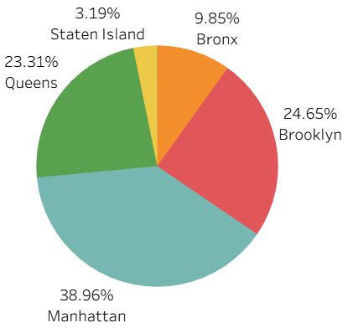
Finding #1 - Geography
Manhattan dominates inspection failures
Potential reasons:
High restaurant density in these areas
Tourist-heavy locations may cause more frequent inspections
Older building infrastructure in some Manhattan neighborhoods
https://data.cityofnewyork.us/Health/DOHMH-New-York-City-Restaurant-Inspection-Results/43nn-pn8j/about_data
Notes:
Insight: Despite representing only 20% of NYC's population, Manhattan accounts for over one-third of all failed inspections. This geographic concentration suggests location-specific factors are at play.

Slide 14
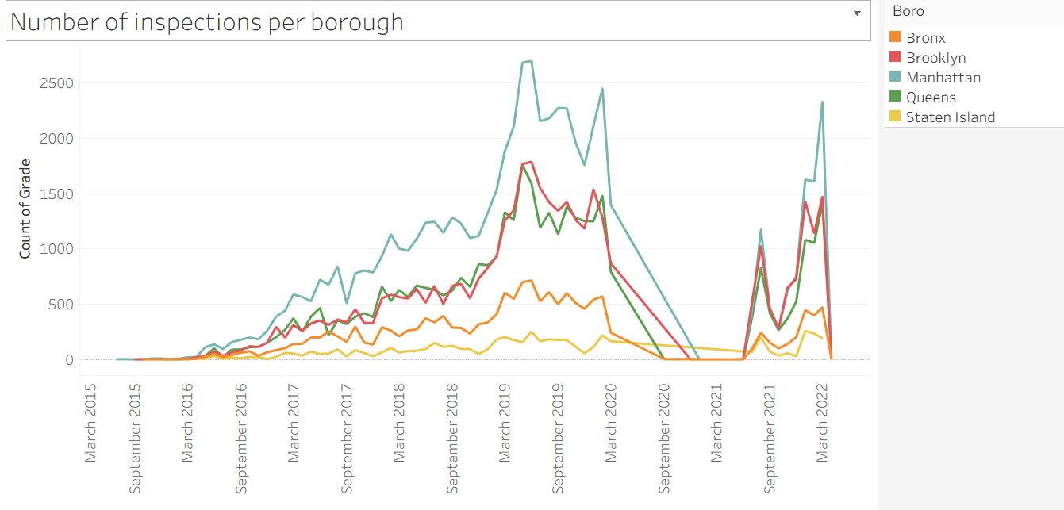
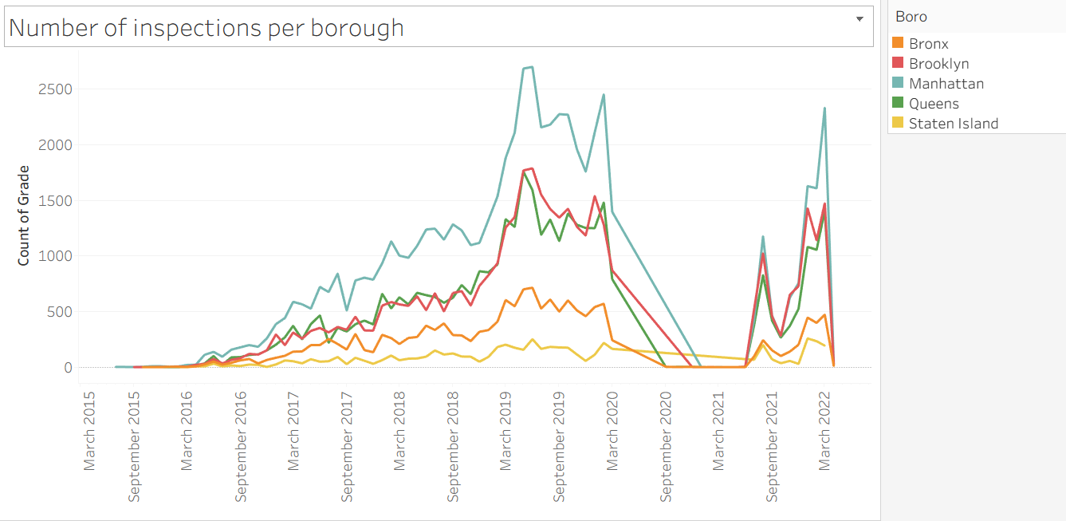
Inspection Trends Over Time by Borough
Manhattan maintains highest failure rate consistently from 2015-2022, with brief COVID-19 disruption in 2020
https://data.cityofnewyork.us/Health/DOHMH-New-York-City-Restaurant-Inspection-Results/43nn-pn8j/about_data
Notes:
OUR DATA SPANNED 2015-2022 This chart shows inspection failures over time by borough. Notice the sharp drop in March 2020, that's the COVID-19 shutdowns. What's interesting is that Manhattan's dominance remains consistent across all time periods, and the pattern recovers post-COVID, showing this isn't a temporary anomaly.

Slide 15
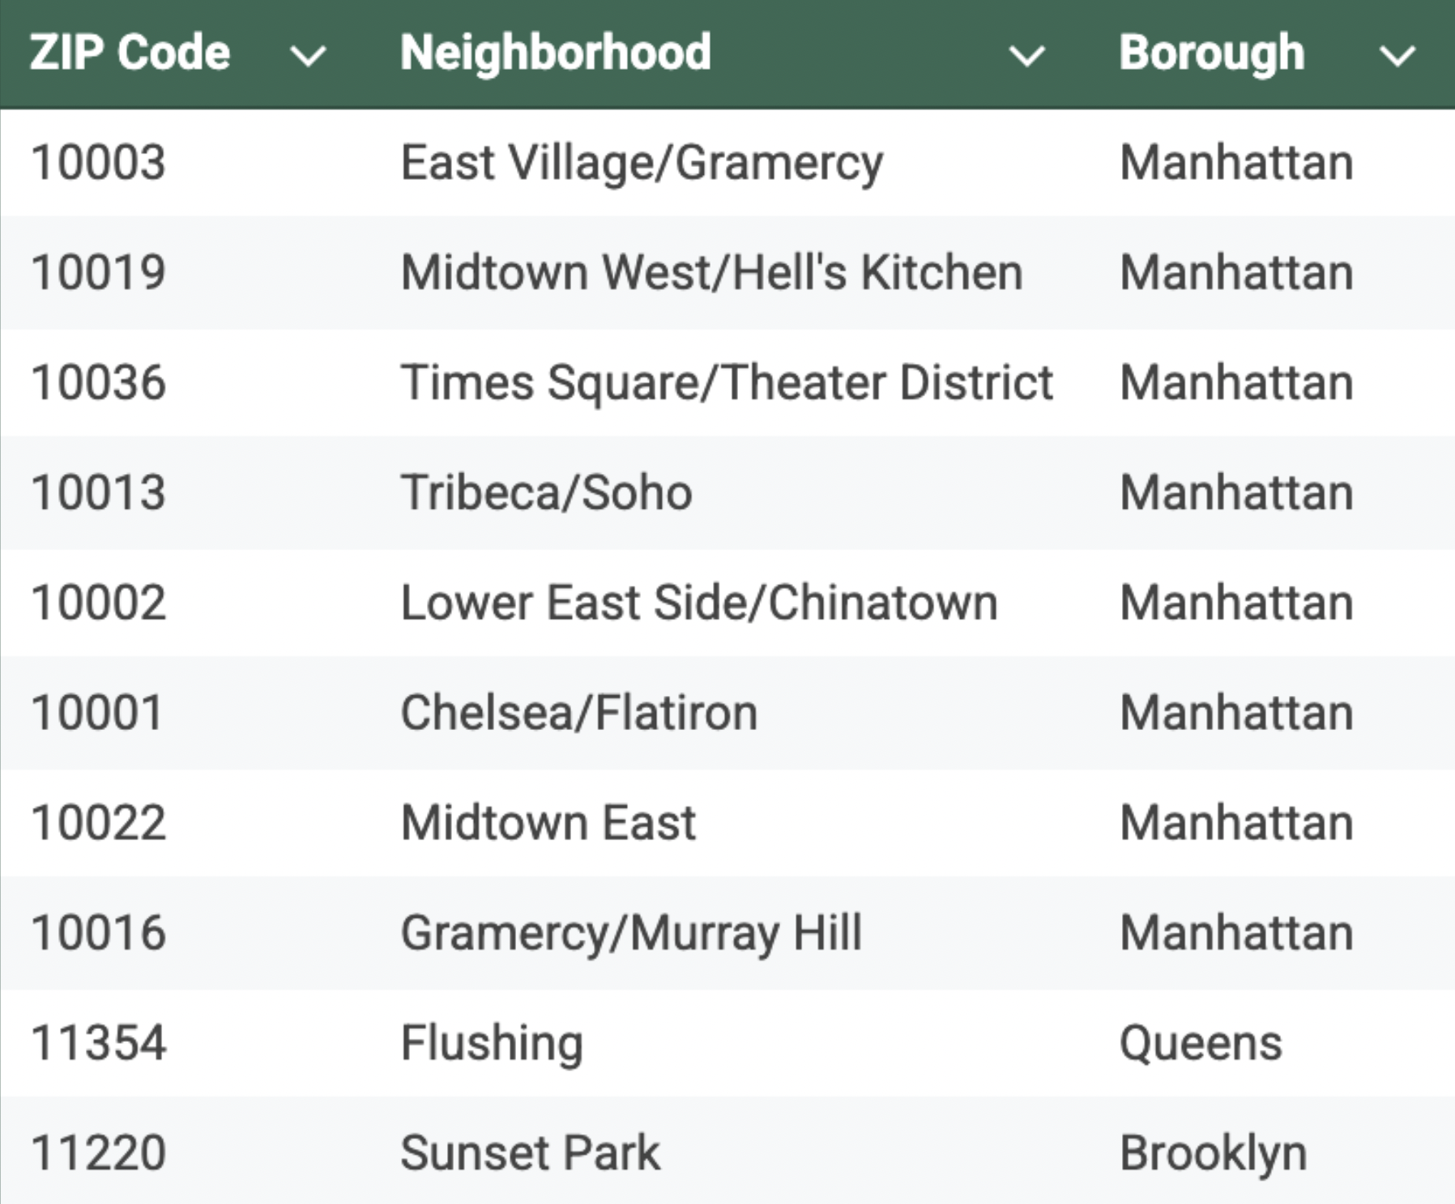
Top 10 ZIP Codes Account for 18% of All Failures
Top 3 Hotspots:
10003 (East Village) - 7,506 violations
10019 (Midtown West) - 7,058 violations
10036 (Times Square) - 6,603 violations
Insight:
8 of top 10 hotspots are in Manhattan's high-traffic tourist and commercial districts
https://data.cityofnewyork.us/Health/DOHMH-New-York-City-Restaurant-Inspection-Results/43nn-pn8j/about_data
Notes:
When we drill down to ZIP code level, the concentration becomes even clearer. The top 10 ZIP codes account for 18% of all failures citywide. Eight of these ten are in Manhattan. The top three hotspots are East Village, Midtown West, and Times Square—all high-density tourist and commercial districts. This suggests that restaurant density, older building stock, and high customer traffic may be contributing factors.

Slide 16
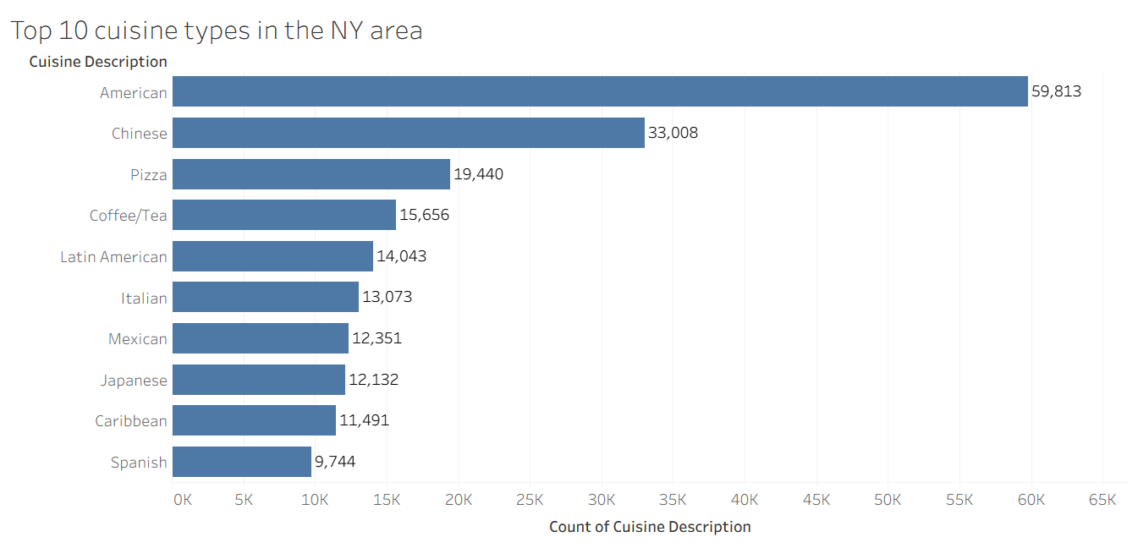
Finding #2 - Cuisine Types
American, Chinese, Pizza lead failures
Key point: Top 5 cuisines = 39% of failures
https://data.cityofnewyork.us/Health/DOHMH-New-York-City-Restaurant-Inspection-Results/43nn-pn8j/about_data
Notes:
Moving to cuisine types, we found that American restaurants lead in failed inspections at 15.5%, followed by Chinese at 9.2% and Pizza at 5.2%. The top five cuisine types collectively account for 39% of all failures. This concentration suggests that targeted training programs for these specific cuisines could have substantial impact. American cuisine restaurants account for the highest number of failed inspections in our sample (18.7%), followed by Chinese (10.32%) and Pizza (6.08%). Notably, Coffee/Tea establishments represent 4.9% of failures despite typically having simpler food preparation processes, suggesting potential compliance gaps in this category.
The top 5 cuisine types—American, Chinese, Pizza, Coffee/Tea, and Latin American—collectively account for 40% of all failed inspections, indicating that targeted interventions for these categories could have substantial impact on overall food safety outcomes
Out of 29000 restaurants 4887 American restaurants accounting for 60k inspections 2181 chinese restaurants accounting for 33K inspections

Slide 17
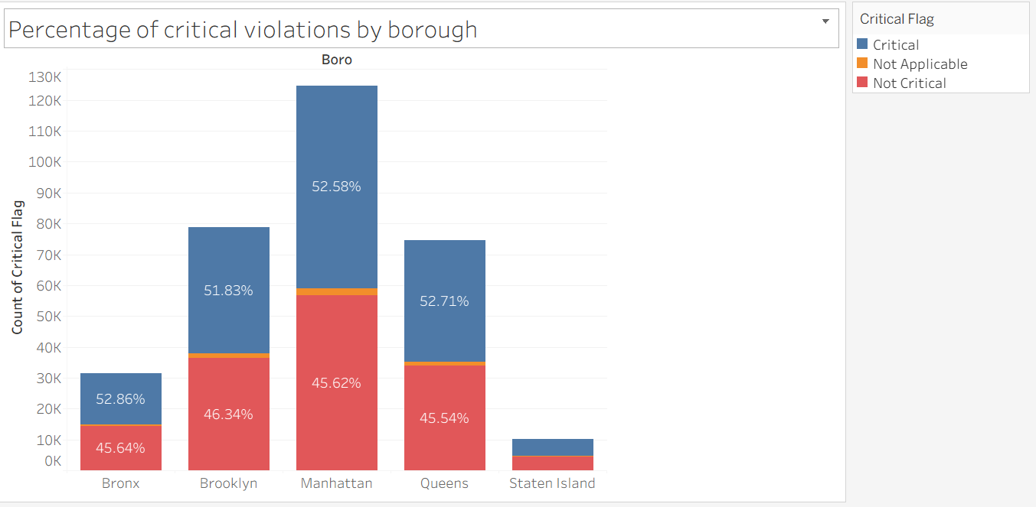
Finding #3 - Severity
Over half of violations in each borough are critical
https://data.cityofnewyork.us/Health/DOHMH-New-York-City-Restaurant-Inspection-Results/43nn-pn8j/about_data
Notes:
Here's a critical finding: over half (52.58%) of all violations are classified as Critical, meaning they pose immediate threats to public health. This isn't about paperwork or minor infractions. We're talking about serious food safety hazards like temperature control failures, contamination, and pest issues. This tells us restaurant failures are driven by genuine safety problems This chart shows how serious most violations actually are. Across all boroughs, more than half of the violations are labeled as critical. That means these aren’t just small paperwork errors — they’re real threats to public health. Examples include things like food being stored at the wrong temperature, contamination from improper cleaning, or pest issues.
What’s important here is that these violations show genuine safety problems inside restaurants — not just missed documentation or inspection timing

Slide 18
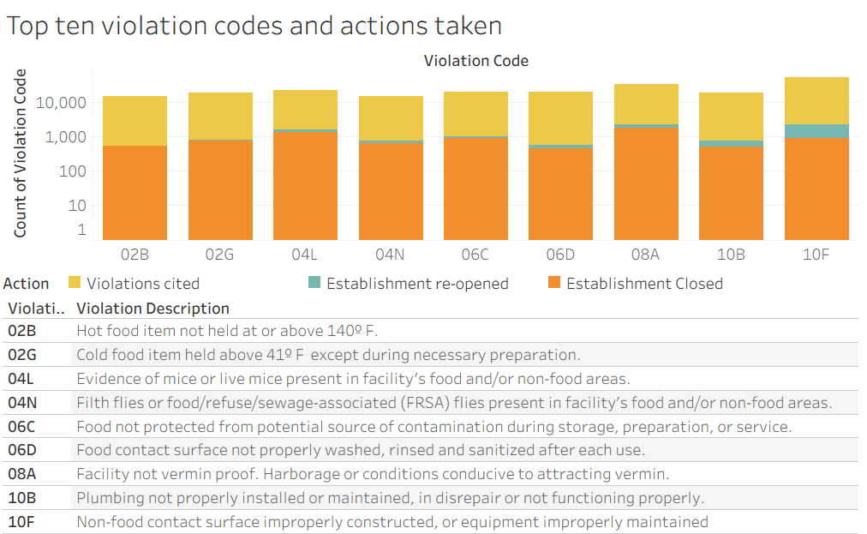
Finding #4 - Violation Types
Infrastructure & pests constitute the majority of restaurant violations.
Improper construction or maintenance 10F(17.5%),
Conditions conducive to attracting vermin
08A (10.6%),
Evidence of mice in facility 04L (7.0%)
Notes:
Due to the concerning amount of critically flagged inspections we decided to take a closer look into NOTE THESE ARE IN LOG SCALE Examining the violation codes cited during these inspections We found that infrastructure and pests constitute the majority of all restaurant inspection
Our top 3 being 10f 08a 04L I would like to draw your attention to our chart and note that it is in log scale so While these top ten constuted more then 2/3rds of all total violations the amount of these violations that led to establishment closures was actually quite low When we examined specific violations, three codes dominate. The most common violation (code 10F at 17.5%) is non-cleanable surfaces, meaning walls, floors, or ceilings in poor condition. Second is code 08A at 10.6%, which indicates facilities that aren't vermin-proof—gaps, holes, or openings. Third is code 04L at 7%, which is evidence of mice. Together, these three violations account for 35% of all violations. The top 10 violations represent nearly 72% of the total.

Slide 19
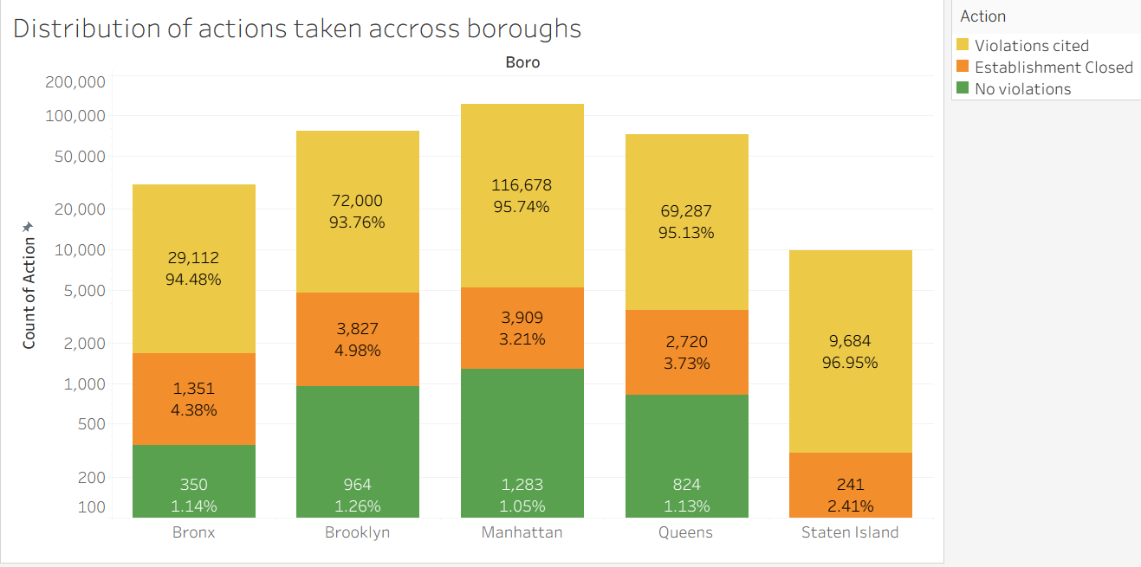
Finding #4 - Violation Types
Despite Manhattan having the most restaurants and violations, it maintains the lowest closure rate of 3.21% as compared to boroughs of similar population density.
https://data.cityofnewyork.us/Health/DOHMH-New-York-City-Restaurant-Inspection-Results/43nn-pn8j/about_data
Notes:
We see this especially while looking at the distributions of actions taken by borough Where closures accounted for less then 5% of all violations Once again we see that manhattan dominates the total number of violations HOWever it manages to maintain the lowest closure rate of 3.21% when compared to boroughs of similar population density NOTE THESE ARE IN LOG SCALE This chart reveals an interesting enforcement pattern across boroughs. Despite Manhattan having the most restaurants and violations (over 116,000 total actions), it maintains the lowest closure rate at just 3.21%. Compare that to Staten Island, which has the highest closure rate at 96.95%, though far fewer total violations. The green sections show 'no violations' found during inspections, while orange represents closures and yellow shows violations cited. Manhattan's approach appears to favor citations and compliance support over closures, which aligns with our recommendation for supportive interventions rather than purely punitive enforcement.

Slide 20
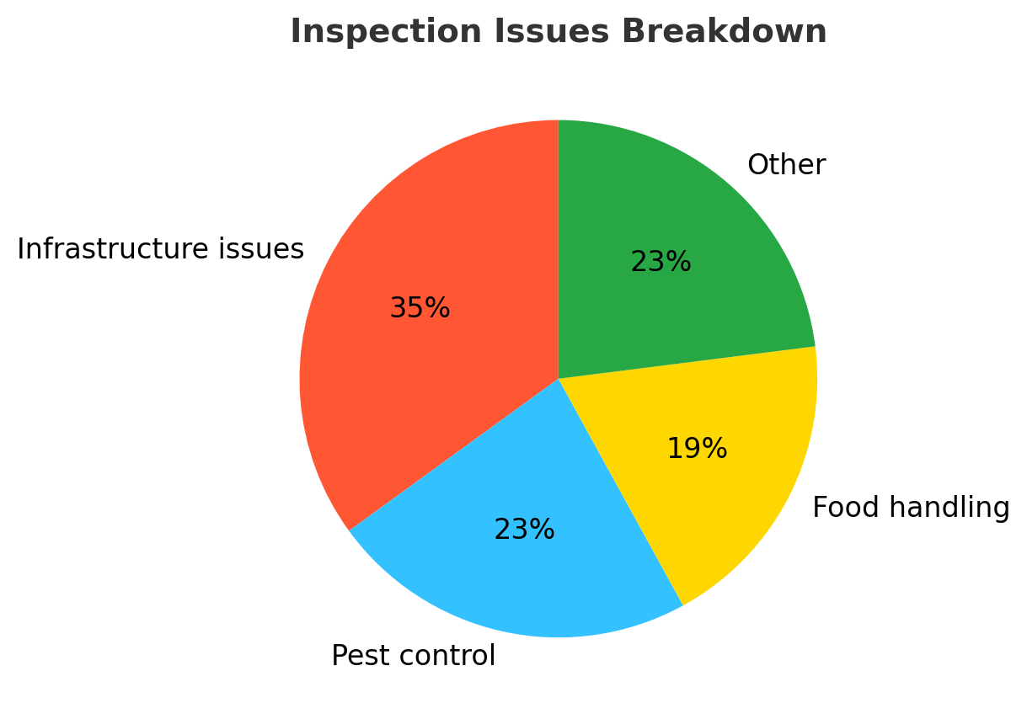
What this means
Problem Categories:
Infrastructure issues: 35%
Pest control: 23%
Food handling: 19%
Other: 23%
Key insight: Building conditions drive failures, not just food handling
https://data.cityofnewyork.us/Health/DOHMH-New-York-City-Restaurant-Inspection-Results/43nn-pn8j/about_data
Notes:
Other includes fire,accessibility When we categorize these violations, a clear pattern emerges. Infrastructure issues account for 35% of violations, pest control for 23%, and food handling for 19%. The remaining 23% includes administrative, employee, and equipment issues. The key insight here is that building conditions—not just food handling practices—are driving the majority of failures.

Slide 21



Recommendations
Notes:
Next are the recommendations

Slide 22
Recommendations
#1 Geographic Hotspot Program
#2 Restaurant Cleanliness Training
#3 Addressing Critical Violations
What: 50% more inspections in top 10 violating ZIP codes
Impact: Concentrates enforcement resources where violations are most prevalent
What: Require staff cleanliness training modules
Impact: Equips restaurant staff with cuisine-specific food safety protocols
What: 48-hour re-inspection period for critical violations
Impact: Ensures immediate correction of serious public health threats
#4 Infrastructure Improvement
#5 Pest Management Program
What: Grants/loans for facility upgrades
Impact: Removes structural barriers preventing compliance in older buildings
What: Subsidized monthly pest control
Impact: Prevents recurring infestations through professional intervention
https://data.cityofnewyork.us/Health/DOHMH-New-York-City-Restaurant-Inspection-Results/43nn-pn8j/about_data
Notes:
Based on our analysis, we've developed five evidence-based recommendations that target the root causes we identified. Each addresses a specific factor contributing to failures. 1. First, establish a Geographic Hotspot Intervention Program. Increase inspection frequency by 50% in the top 10 ZIP codes and provide targeted compliance support through community partnerships. This concentrates resources where violations are most prevalent and could dramatically improve outcomes in Manhattan's highest-risk areas. 2. Second, develop restaurant-specific training programs. Create customized food safety modules for the top five cuisine types through partnerships with restaurant associations. Make training mandatory for prior violators and offer it in multiple languages. This equips staff with relevant, practical protocols tailored to their specific operational challenges. 3. Third, implement a Critical Violation Fast Response Protocol. Require re-inspection within 48 hours for any critical violation, with temporary closure until corrected. Assign dedicated compliance officers to work with repeat violators. This ensures immediate correction of serious public health threats rather than letting them persist
4. Fourth, launch a Building Infrastructure Improvement Program. Provide grants and low-interest loans to help restaurants upgrade facilities, particularly in older buildings. Subsidize pest-proofing, surface repairs, and plumbing improvements. Require landlords to share costs for building-level issues. This removes structural barriers that prevent compliance, especially for small businesses in aging buildings.
5. Fifth, establish an Integrated Pest Management Program. Mandate monthly professional pest control for restaurants with prior pest violations and subsidize these services for small businesses. Create a 'pest-free certification' program with public recognition. Coordinate with the Sanitation Department on neighborhood-level abatement. This prevents recurring infestations through proactive, professional intervention.

Slide 23


Conclusion
Notes:
We’re reaching the end of our presentation.

Slide 24

Conclusion
Key Takeaways:
Addressing infrastructure and location-specific issues, not just penalizing repeat violations, creates sustainable food safety improvement
Impact:
Potential to prevent thousands of foodborne illness cases annually
This approach shifts from punishment to support, helping restaurants succeed rather than just citing failures
Next steps:
Further analysis needed on repeat offender patterns
Evaluation of programs after a 12-month pilot
Cost-benefit analysis of grant programs
https://data.cityofnewyork.us/Health/DOHMH-New-York-City-Restaurant-Inspection-Results/43nn-pn8j/about_data
Notes:
In conclusion, NYC restaurant failures are driven primarily by infrastructure deficiencies and pest control issues, concentrated in Manhattan neighborhoods with older building stock. Our five targeted interventions address these root causes rather than just penalizing symptoms. By shifting from enforcement to support, NYC can create a more effective, sustainable approach to food safety that helps restaurants succeed while protecting public health.

Slide 25
Disclaimer - Inconsistent Health Score reporting
The NYC Department of Health and Mental Hygiene(DOHMH) assigns letter grades using a clear scoring system.
However, scores are sometimes released without an updated grade, or old grades are kept despite new scores.
This leads to inconsistent reporting across restaurants.
Businesses are impacted when third-party platforms like Yelp, Uber Eats, and DoorDash rely on outdated or mismatched data to promote restaurants.
https://data.cityofnewyork.us/Health/DOHMH-New-York-City-Restaurant-Inspection-Results/43nn-pn8j/about_data
Notes:
We need to address an important data quality issue we discovered. While NYC's Department of Health assigns letter grades using a clear scoring system, we found that scores are sometimes released without an updated grade, or old grades are kept despite new scores. This leads to inconsistent reporting across restaurants and impacts businesses when third-party platforms like Yelp, Uber Eats, and DoorDash rely on outdated or mismatched data to promote restaurants. This inconsistency was one challenge we had to work around in our analysis."

Slide 26
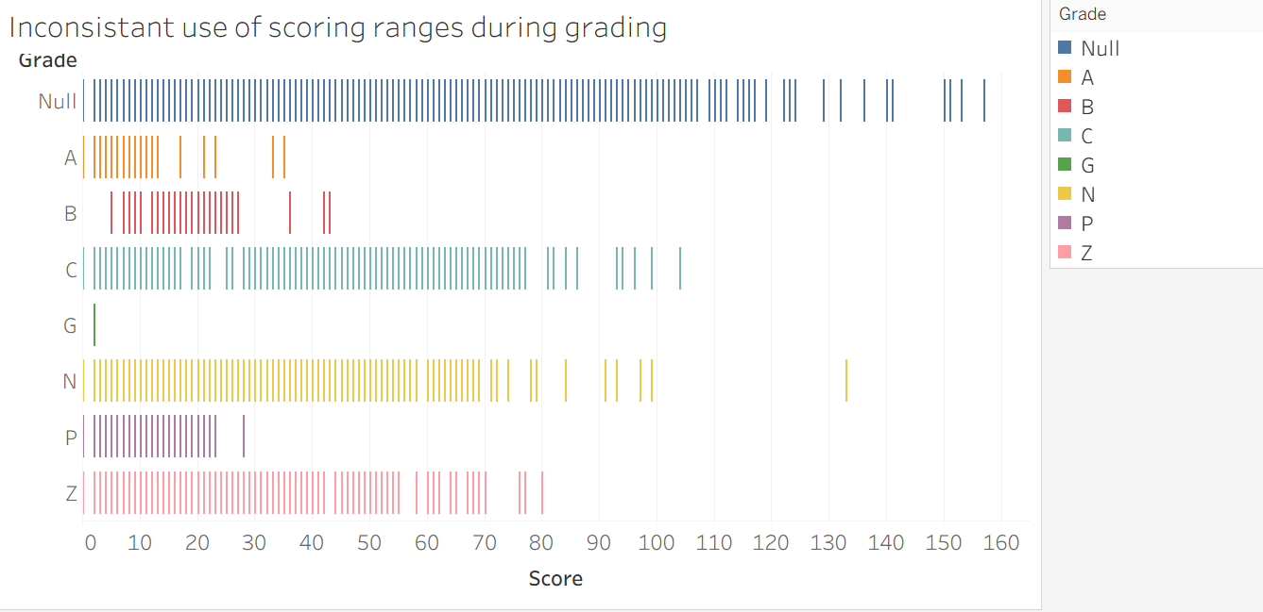
Finding #5 - Inconsistent reporting
The grades should represent scores of A 0–13
B 14–27
C 28+ And G,N,P,Z representing non finalized grading
However consistently the scores exist outside of their ranges.
https://data.cityofnewyork.us/Health/DOHMH-New-York-City-Restaurant-Inspection-Results/43nn-pn8j/about_data
Notes:
This visualization exposes a major data quality issue in NYC's grading system. According to the official system, grades should follow clear score ranges: A for 0-13, B for 14-27, C for 28 and above, with G, N, P, and Z representing non-finalized grades. However, look at this chart, each vertical line represents an individual inspection, and you can see scores consistently falling outside their designated ranges. For example, grade A should only contain scores from 0-13, but you can see orange lines scattered across the entire spectrum, even reaching scores of 100 or higher. This inconsistency made it challenging to rely on grades alone in our analysis.

Slide 27
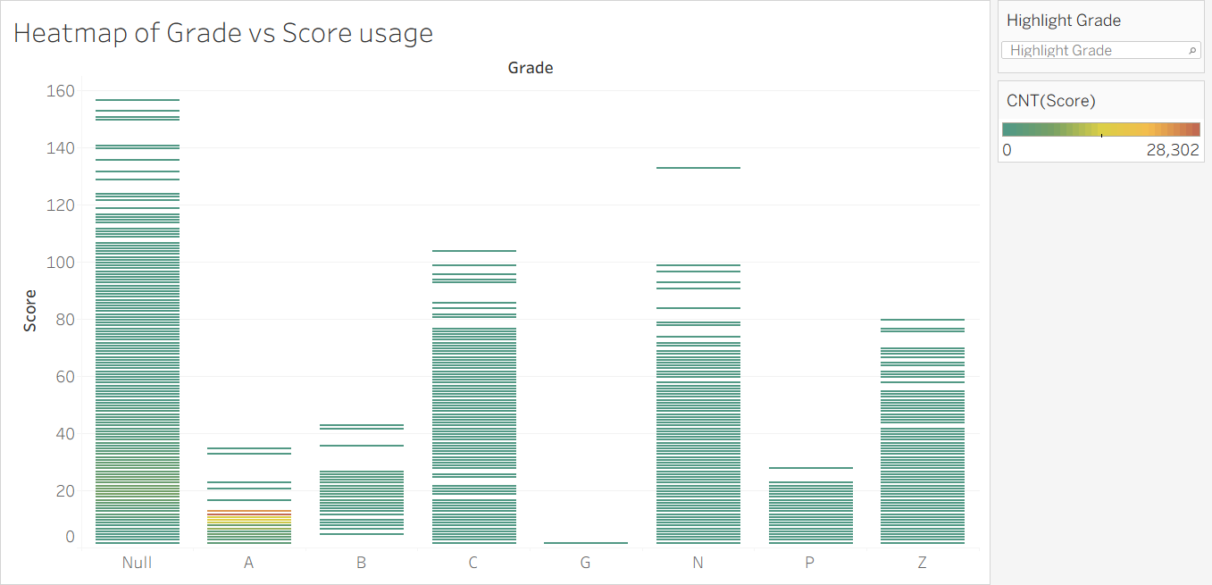
Finding #5 - Inconsistent reporting
The vast majority of scores are given in the Grade of A, despite similar scores distributed across all grades
https://data.cityofnewyork.us/Health/DOHMH-New-York-City-Restaurant-Inspection-Results/43nn-pn8j/about_data
Notes:
This heat map reveals the core of the grading problem. Each horizontal line represents an inspection with its score and assigned grade. The vast majority of scores are concentrated in the 'A' grade column.. However, look at what the red arrow is pointing to: scores between 0 and 40 in grade A. But identical score ranges also appear in grades B, C, and even the null category. If the grading system were consistent, we'd see clear separation > low scores only in A, medium in B and C, high scores in the non-finalized categories. Instead, similar scores receive completely different grades, making grade-based analysis unreliable.

Slide 28
Resources
https://data.cityofnewyork.us/Health/DOHMH-New-York-City-Restaurant-Inspection-Results/43nn-pn8j/about_data
Notes:
Our analysis was based on NYC Open Data, DOHMH New York City Restaurant Inspection Results dataset.

Slide 29

Thank you!

